Slide 1
Introduction

Slide 2
Definition of a Distributed System (1)
A distributed system is:
A collection of independent computers that appears to its users as a single coherent system.
Characteristic features
Autonomous computing elements, also referred to as nodes, be they are hardware devices or software processes.
Single coherent system: users or applications perceive a single system ⇒ nodes need to collaborate.
Notes:
Have a quick discussion about what are the potential problems of a single centralized system.
Single point of failure
Difficult to support concurrency: even though the single centralized system has very powerful CPU, memory and disk drives, the network (Internet) could be a bottleneck

Slide 3
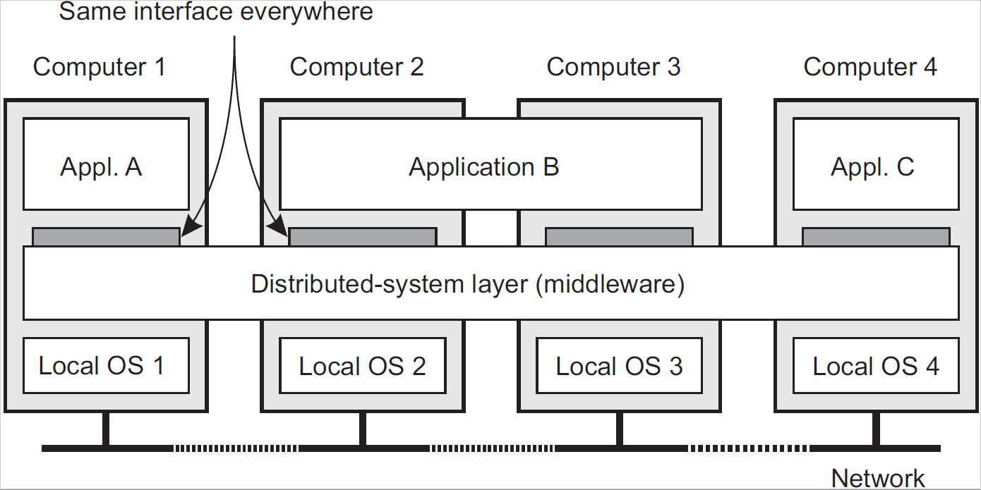
Definition of a Distributed System (2)
Commonly used components and functions that need not be implemented by applications separately.
A distributed system organized as middleware. Note that the middleware layer extends over multiple machines.
Notes:
Can you give an example?
Web (HTTP)
FTP

Slide 4
What do we want to achieve?
Support sharing of resources Transparency
Openness
Scalability

Slide 5
Sharing resources
Examples
Cloud-based shared storage and files
Peer-to-peer assisted multimedia streaming
Shared mail services (think of outsourced mail systems)

Slide 6
Transparency in a Distributed System
Transparency | Description
Access | Hide differences in data representation and how a resource is accessed
Location | Hide where a resource is located
Migration | Hide that a resource may move to another location
Relocation | Hide that a resource may be moved to another location while in use
Replication | Hide that a resource is replicated
Concurrency | Hide that a resource may be shared by several competitive users
Failure | Hide the failure and recovery of a resource
Persistence | Hide whether a (software) resource is in memory or on disk
Different forms of transparency in a distributed system.

Slide 7
Openness of distributed systems
Be able to interact with services from other open systems, irrespective of the underlying environment:
Systems should conform to well-defined interfaces
interface: e.g., a common interface like HTTP
Systems should easily interoperate
interoperate: two implementations of systems or components from different manufacturers can co-exist and work together by merely relying on each other’s services as specified by a common standard
Systems should support portability of applications
portability: application developed for distributed system (DS) A can be executed without modification on a different DS B
Systems should be easily extensible
extensible: ability to add on to a system or replace components of a system with different components.
Notes:
Interfaces – well-defined = IDL or perhaps a common interface like HTTP, basically implies some sort of formal description of the interface.
Interoperability – characterizes the extent by which two implementations of systems or components from different manufacturers can co-exist and work together by merely relying on each other’s services as specified by a common standard
Portability – characterizes to what extent application developed for DS A can be executed without modification on a different DS B
Extensible – ability to add on to a system or replace components of a system with different components.

Slide 8
Scalability Problems
Concept | Example
Centralized services | A single server for all users
Centralized data | A single on-line telephone book
Centralized algorithms | Doing routing based on complete information
Examples of scalability limitations.

Slide 9
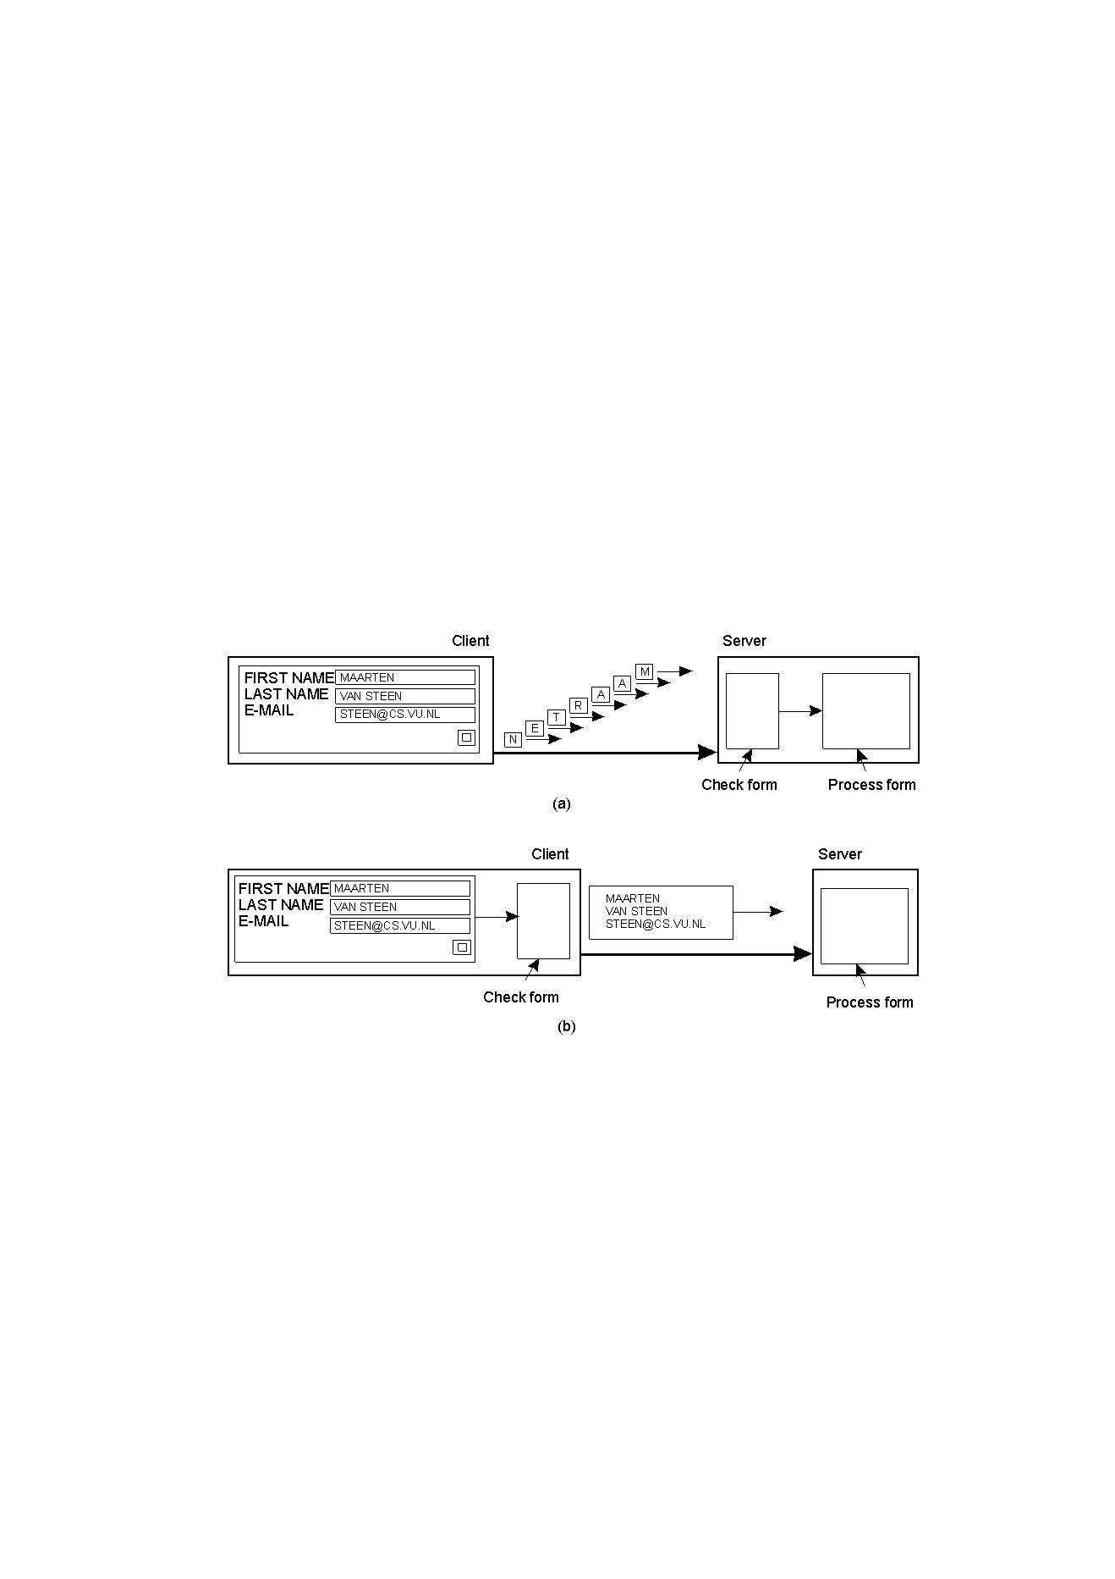
Scaling Techniques (1)
Facilitate solution by moving computations to client
1.4
The difference between letting:
a server or
a client check forms as they are being filled

Slide 10
Scaling Techniques (2)
Partition data and computations across multiple machines
Replication: Make copies of data available at different machines
Applying replication is easy, except for one thing
Having multiple copies, leads to inconsistencies: modifying one copy makes that copy different from the rest.
Always keeping copies consistent and in a general way requires global synchronization on each modification.
Global synchronization precludes large-scale solutions.

Slide 11
Developing distributed systems: Pitfalls
Observation
Many distributed systems are needlessly complex caused by mistakes that required patching later on. Many false assumptions are often made.
False (and often hidden) assumptions
The network is reliable
The network is secure
The network is homogeneous
The topology does not change
Latency is zero
Bandwidth is infinite
Transport cost is zero
There is one administrator

Slide 12
Different types of distributed computing
Parallel Computing
Cluster Computing
Grid Computing
Cloud Computing
Pervasive Computing

Slide 13
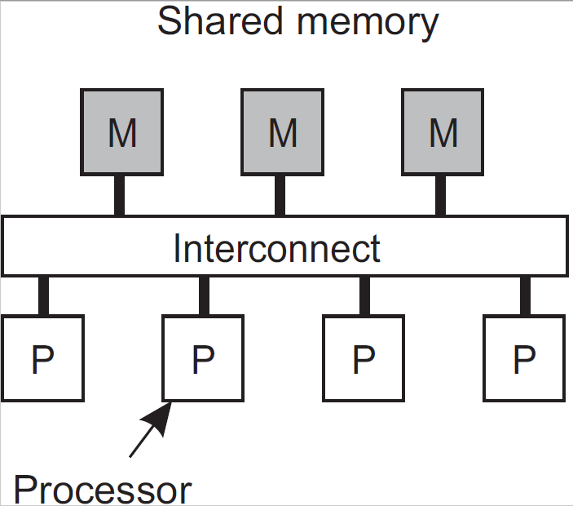
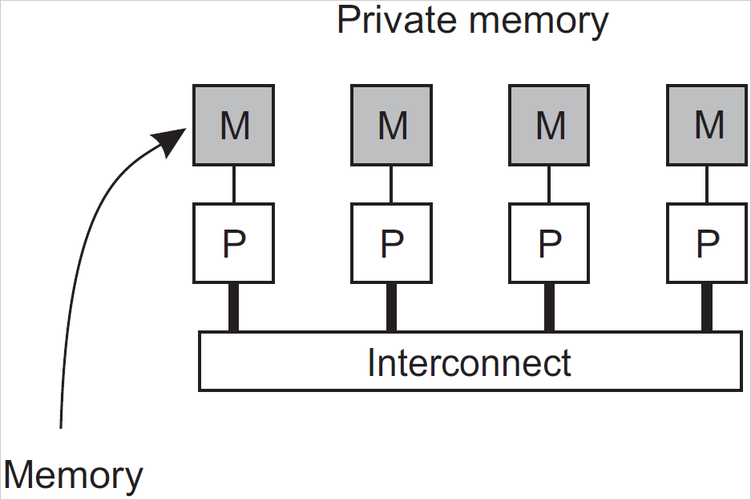
Parallel Computing
Multiprocessor vs. multicomputer
Multiprocessors are relatively easy to program in comparison to multicomputers, yet have problems when increasing the number of processors
Notes:
Scale-up vs. Scale-out

Slide 14
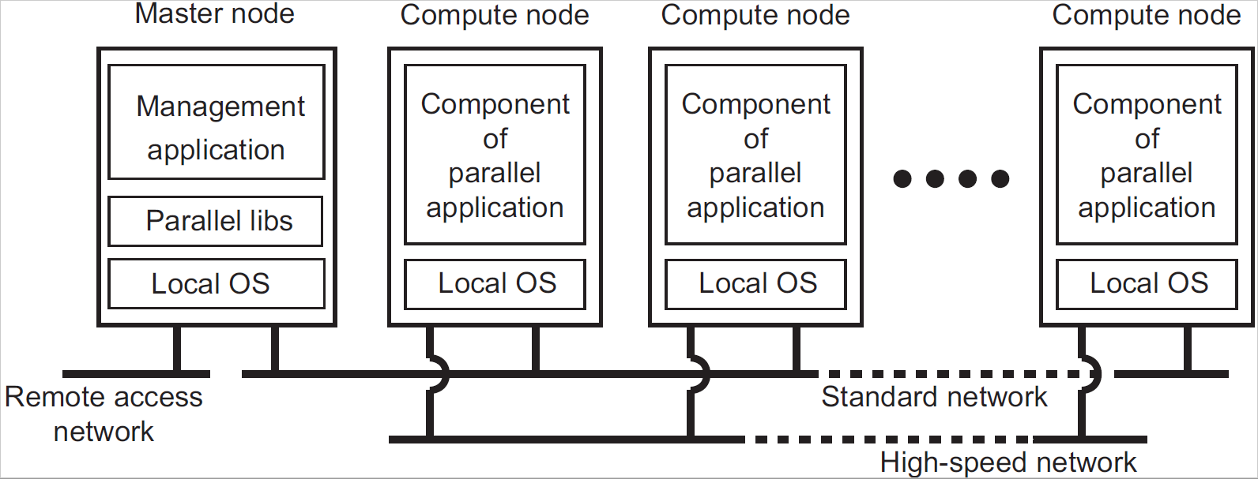
Cluster Computing
Essentially a group of high-end systems connected through a LAN
Homogeneous: same OS, near-identical hardware
Single managing node

Slide 15
Grid Computing
The next step: lots of nodes from everywhere
Heterogeneous
Dispersed across several organizations
Can easily span a wide-area network

Slide 16
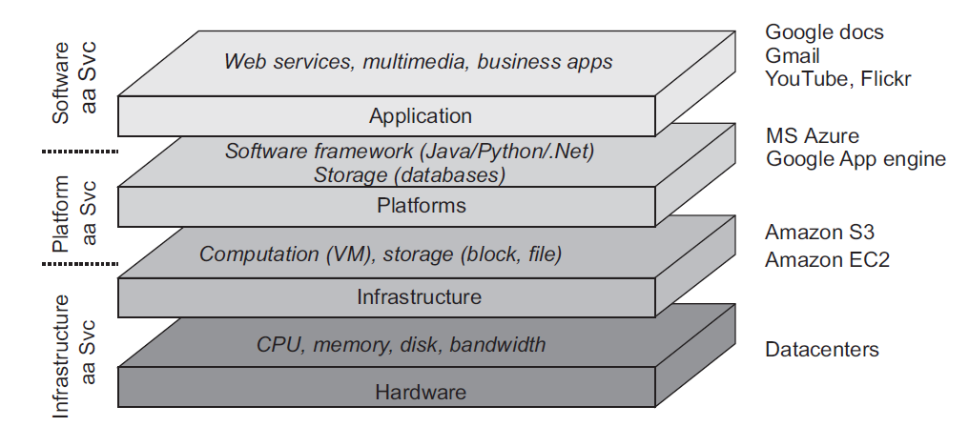
Cloud Computing (1)

Slide 17
Cloud Computing (2)
Make a distinction among four layers
Hardware: Processors, routers, power and cooling systems. Customers normally never get to see these.
Infrastructure: Deploys virtualization techniques. Evolves around allocating and managing virtual storage devices and virtual servers.
Platform: Provides higher-level abstractions for storage and such.
Application: Actual applications, such as office suites (text processors, spreadsheet applications, presentation applications). Comparable to the suite of apps shipped with OSes.

Slide 18
Pervasive Computing (1)
Emerging next-generation of distributed systems in which nodes are small, mobile, and often embedded in a larger system, characterized by the fact that the system naturally blends into the user’s environment.
Three (overlapping) subtypes
Ubiquitous computing systems: pervasive and continuously present, i.e., there is a continuous interaction between system and user.
Mobile computing systems: pervasive, but emphasis is on the fact that devices are inherently mobile.
Sensor (and actuator) networks: pervasive, with emphasis on the actual (collaborative) sensing and actuation of the environment.
Notes:
Show IoT devices

Slide 19
Pervasive Computing (2)
Internet
Host intranet
GSM/GPRS
Home intranet
Wireless LAN
gateway
Mobile
phone
Printer
Laptop
Camera
Host site

Slide 20
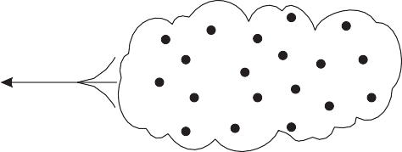
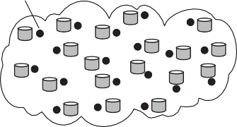

Pervasive Computing (3)
Sensor networks: Two types
Sensor network
Operator's site
Sensor data is sent directly to operator
Each sensor can process and store data
Sensor network
Operator's site
Query
Sensors send only answers

Slide 21
Examples of Distributed Systems (1)
Local Area Network

Slide 22
Examples of Distributed Systems (2)
intranet
%
ISP
%
%
%
backbone
satellite link
desktop computer:
server:
network link:
Internet

Slide 23
Examples of Distributed Systems (3)
http://www.google.com
www.google.com
Web servers
Browsers
www.uu.se
Internet
http://www.gvsu.edu/
www.w3c.org
File system of
http://www.w3c.org/Protocols/Activity.html
www.w3c.org
Protocols
Activity.html
Web Servers and Web Brower

Slide 24
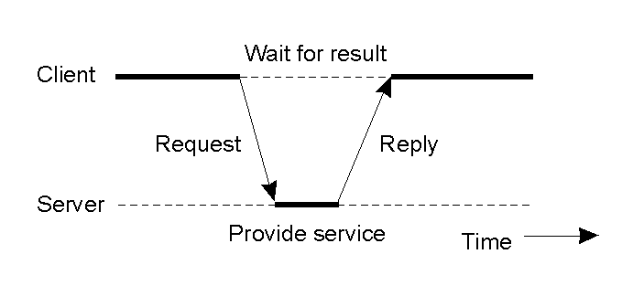
System Architecture (1)
1.25
General interaction between a client and a server.
Client-Server

Slide 25
System Architecture (2)
Client-Server

Slide 26
System Architecture (3)
Peer-to-peer

Slide 27
System Architecture (4)
A Service by Multiple Servers
Notes:
Load sharing
Redundancy

Slide 28
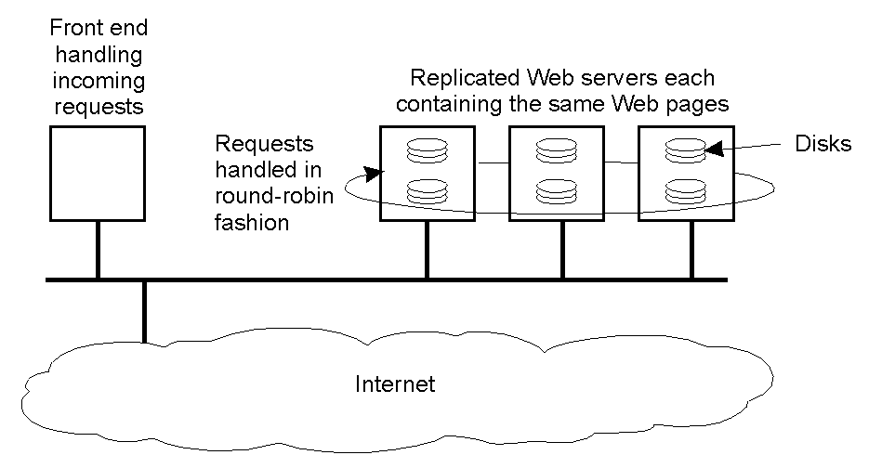
System Architecture (5)
1-31
An example of horizontal distribution of a Web service.
A Service by Multiple Servers

Slide 29
System Architecture (6)
Web Applets

